Slide 1

Team Name : Lalit Team
Team Leader Name : Lalit Rajpurohit
Problem Statement : Farmers lack timely insights and tools to prevent crop losses, optimize resources, and maximize income.

Slide 2
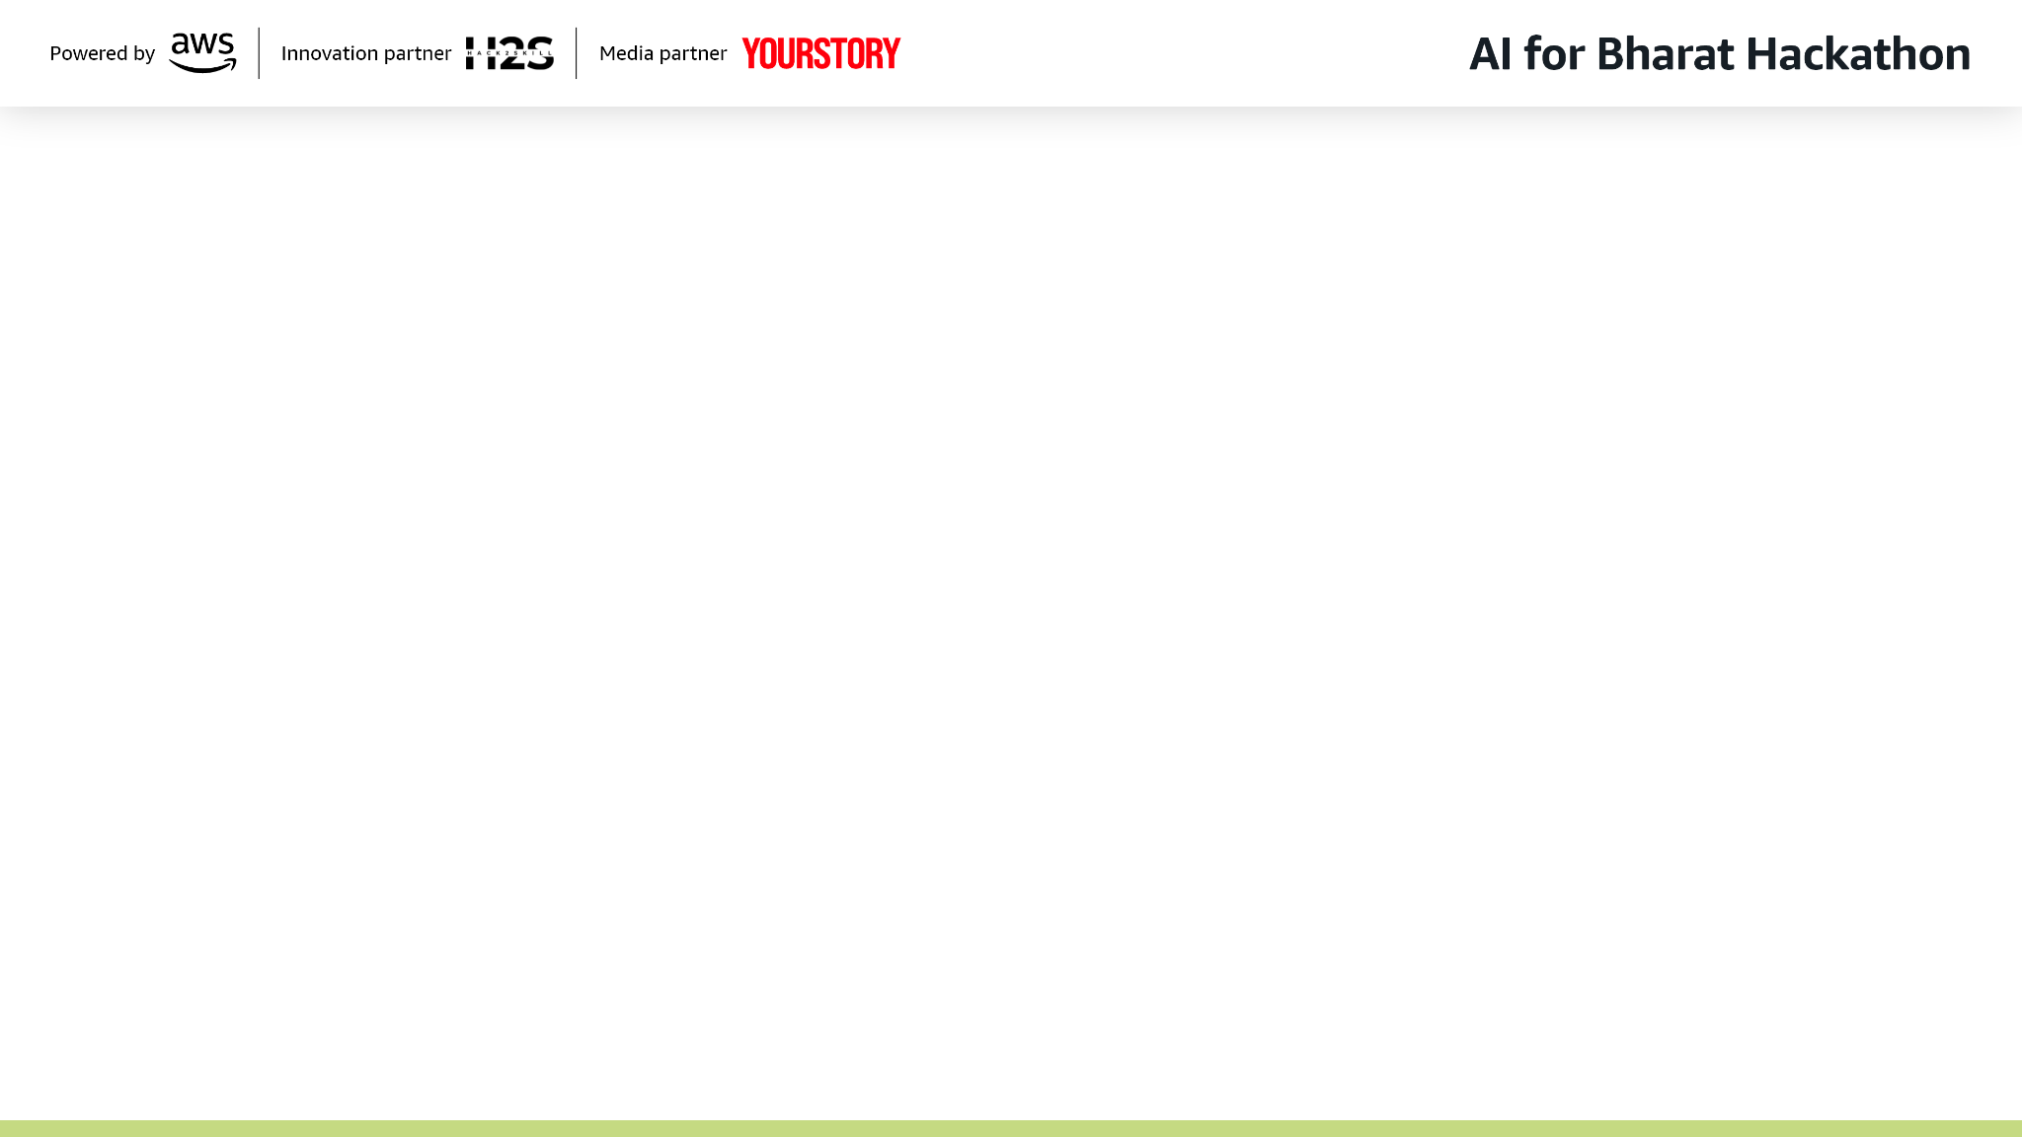
Brief about the Idea: KrishiAI is an intelligent agriculture support platform designed to empower farmers by leveraging the power of Artificial Intelligence, data analytics, and mobile technology to address some of the most critical challenges faced in modern farming. The platform provides farmers with real-time insights and decision support tools that help improve crop productivity, reduce losses, and optimize the use of resources such as water, fertilizers, and pesticides. Through advanced image recognition technology, farmers can capture photos of crops using their smartphones to detect diseases at an early stage and receive accurate treatment recommendations, preventing large-scale crop damage. In addition, the platform offers smart irrigation guidance by analyzing soil moisture levels, weather forecasts, and crop requirements to recommend the right amount of water at the right time, helping conserve water and improve crop health. KrishiAI also includes a multilingual AI chatbot that provides instant agricultural advice, answers farmer queries, and shares best farming practices in local languages, making expert knowledge more accessible even in rural areas. Furthermore, the system integrates market price insights and predictive analytics to help farmers make informed decisions about when and where to sell their produce, ultimately increasing their profitability. By combining artificial intelligence with user-friendly mobile applications, KrishiAI aims to bridge the gap between technology and traditional farming, promote sustainable agricultural practices, enhance rural livelihoods, and contribute to overall agricultural growth and food security.

Slide 3
✅ How is it different from existing solutions?
KrishiAI stands out by combining multiple AI capabilities into a single, easy-to-use mobile platform specifically designed for small and medium farmers. Unlike many existing tools that focus on only one feature such as weather updates or market prices, KrishiAI integrates crop disease detection, smart irrigation recommendations, market insights, and a multilingual AI assistant in one ecosystem. The platform is built with an offline-first approach to ensure usability in low-connectivity rural areas, and it provides localized recommendations tailored to crop type, region, and weather conditions. This holistic approach makes it more practical and accessible compared to fragmented solutions currently available.
✅ How will it solve the problem?
KrishiAI solves key agricultural challenges by providing farmers with real-time, data-driven insights that enable better decision-making. Using AI image recognition, farmers can detect crop diseases early and receive treatment recommendations, reducing crop losses. Smart irrigation guidance helps optimize water usage based on soil and weather data, improving efficiency and sustainability. The AI chatbot provides instant expert advice in local languages, bridging the knowledge gap for farmers who lack access to agricultural experts. Additionally, market price insights help farmers decide the best time to sell their produce, improving income stability. By addressing productivity, resource management, and information access together, the platform provides a comprehensive solution to major farming challenges.
✅ USP (Unique Selling Proposition)
The unique strength of KrishiAI lies in its all-in-one intelligent farming assistant that delivers personalized, real-time recommendations through a simple mobile interface. Its key differentiators include offline capability, multilingual AI support, localized insights, and integration of multiple smart farming features into a single platform. By making advanced agricultural intelligence affordable and accessible, KrishiAI empowers farmers to adopt data-driven farming practices without needing expensive equipment or technical expertise.

Slide 4
✅ List of Features Offered by the Solution:
🌱 Crop Disease Detection
Detect plant diseases using smartphone camera
AI-powered image recognition with confidence score
Early detection to prevent crop losses
Treatment and prevention recommendations
💧 Smart Irrigation Advisory
Soil moisture–based irrigation guidance
Weather-based watering recommendations
Suggested water quantity and schedule
Helps reduce water wastage
🤖 AI Farming Assistant (Chatbot)
Instant answers to farming questions
Multilingual support (local languages)
Best practices and expert guidance
Voice input support
🌦️ Weather Insights & Alerts
Real-time weather updates
Forecast for better crop planning
Extreme weather alerts
Seasonal recommendations
📈 Market Price Insights
Live crop market prices
Price trend predictions
Sell timing recommendations
Helps maximize farmer profits
🗺️ Field Management
Add and manage multiple fields
Crop tracking and history
Health status monitoring
Farm activity records
🔔 Smart Alerts & Notifications
Pest outbreak alerts
Disease risk warnings
Irrigation reminders
Market change alerts
📊 Farm Analytics Dashboard
Crop performance insights
Yield tracking
Resource usage analysis
Decision support metrics
🌍 Offline Mode Support
Works in low or no internet areas
Syncs data when connection returns
🔐 Secure Farmer Profile
Personal farm profile
Data privacy and secure storage
Language preferences
🗺️ Field Management
Add and manage multiple fields
Crop tracking and history
Health status monitoring
Farm activity records
🔔 Smart Alerts & Notifications
Pest outbreak alerts
Disease risk warnings
Irrigation reminders
Market change alerts
📊 Farm Analytics Dashboard
Crop performance insights
Yield tracking
Resource usage analysis
Decision support metrics
🌍 Offline Mode Support
Works in low or no internet areas
Syncs data when connection returns
🔐 Secure Farmer Profile
Personal farm profile
Data privacy and secure storage
Language preferences

Slide 5
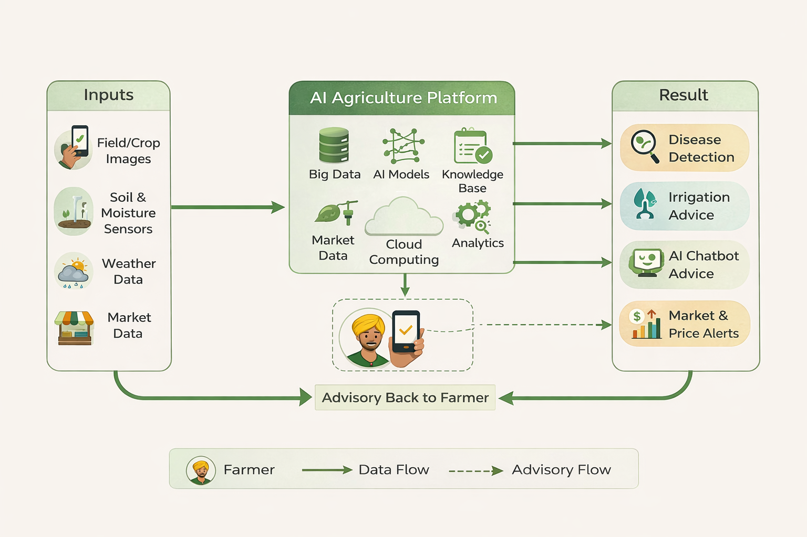
Flow diagram:

Slide 6
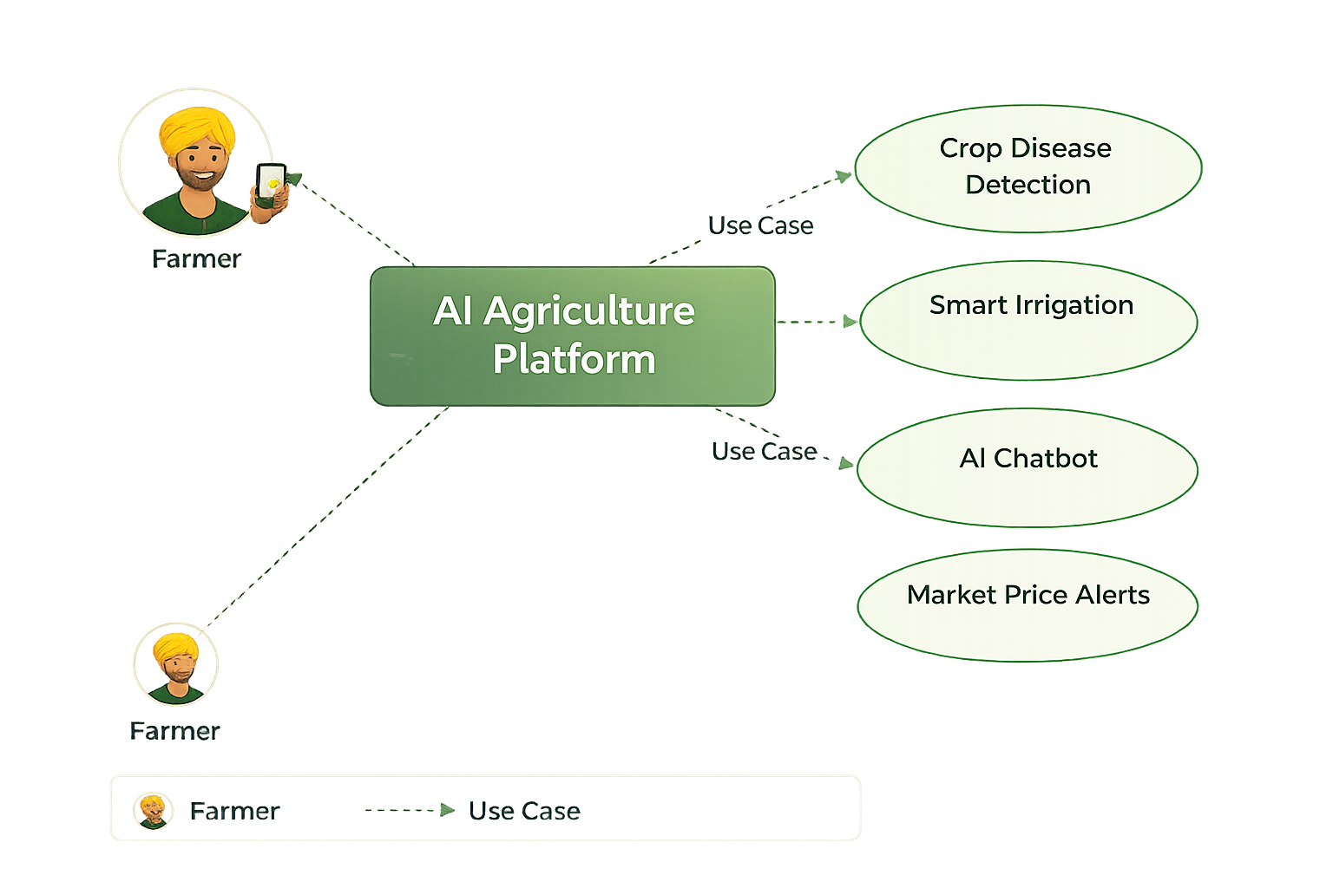
Use-Case Diagram:

Slide 7
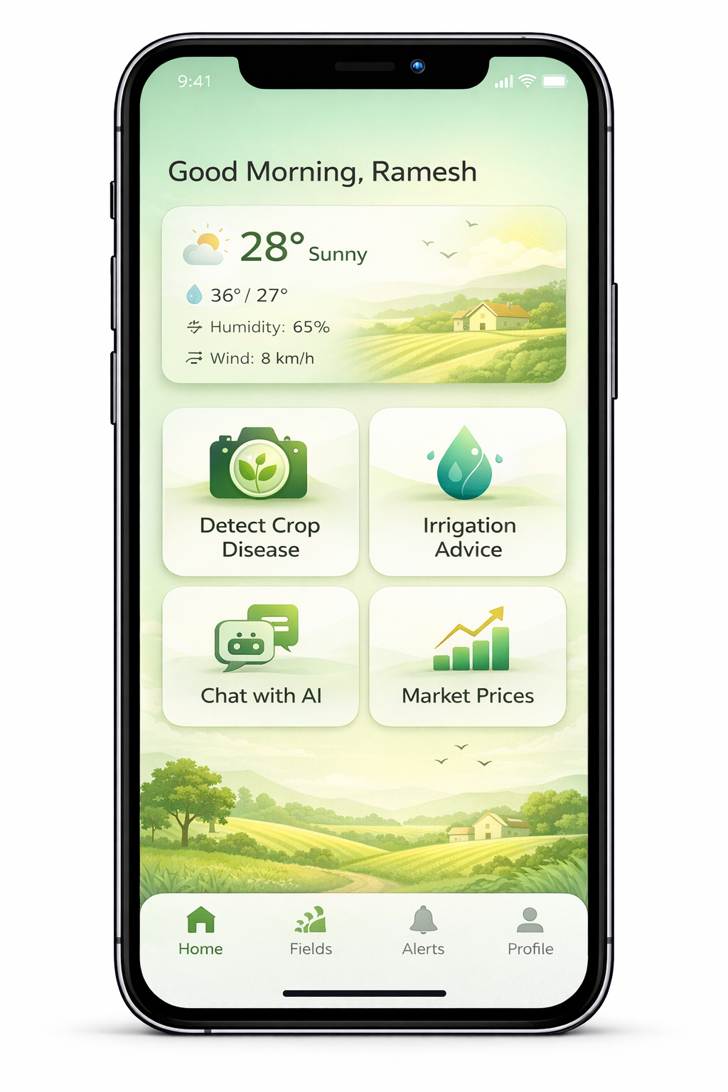
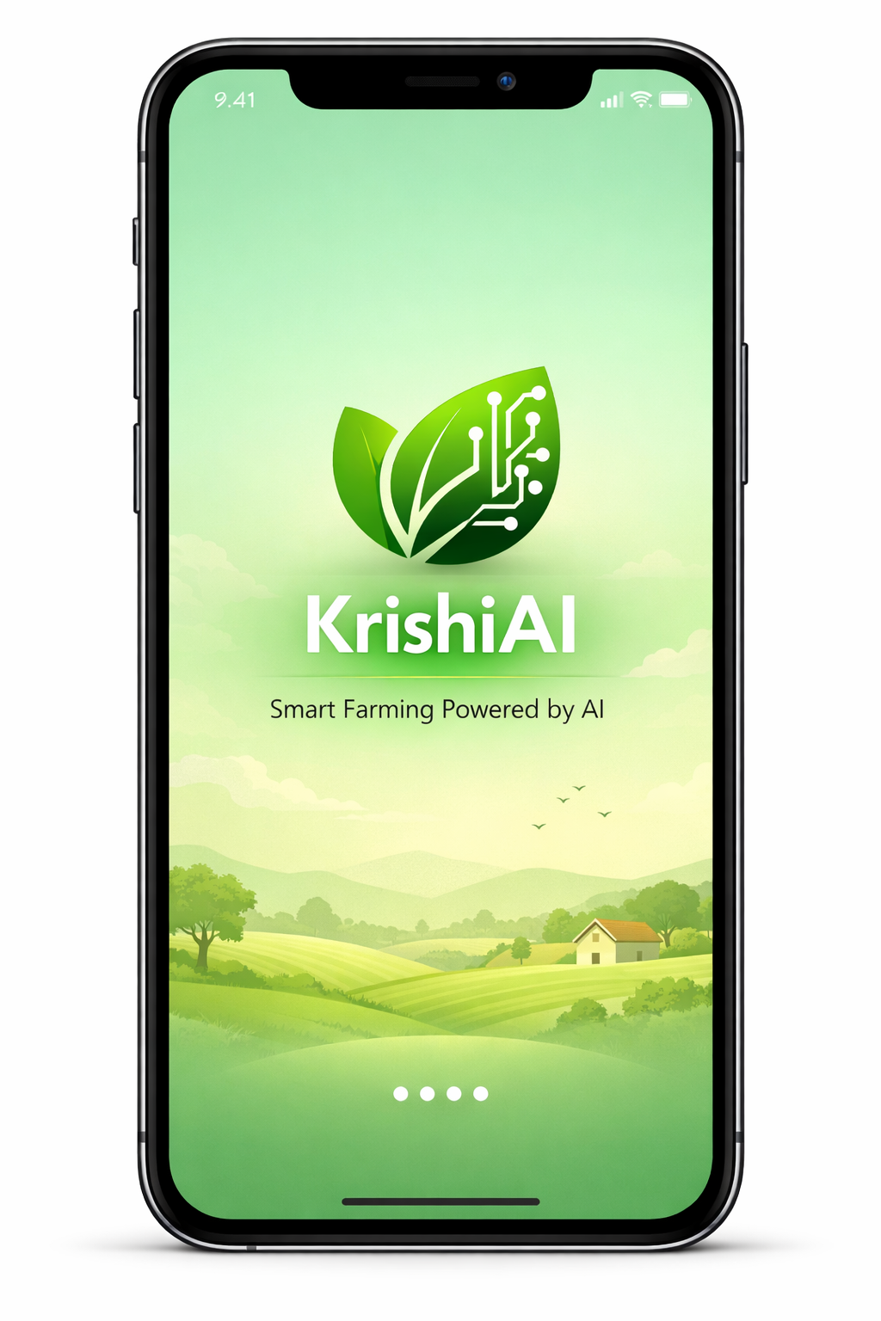
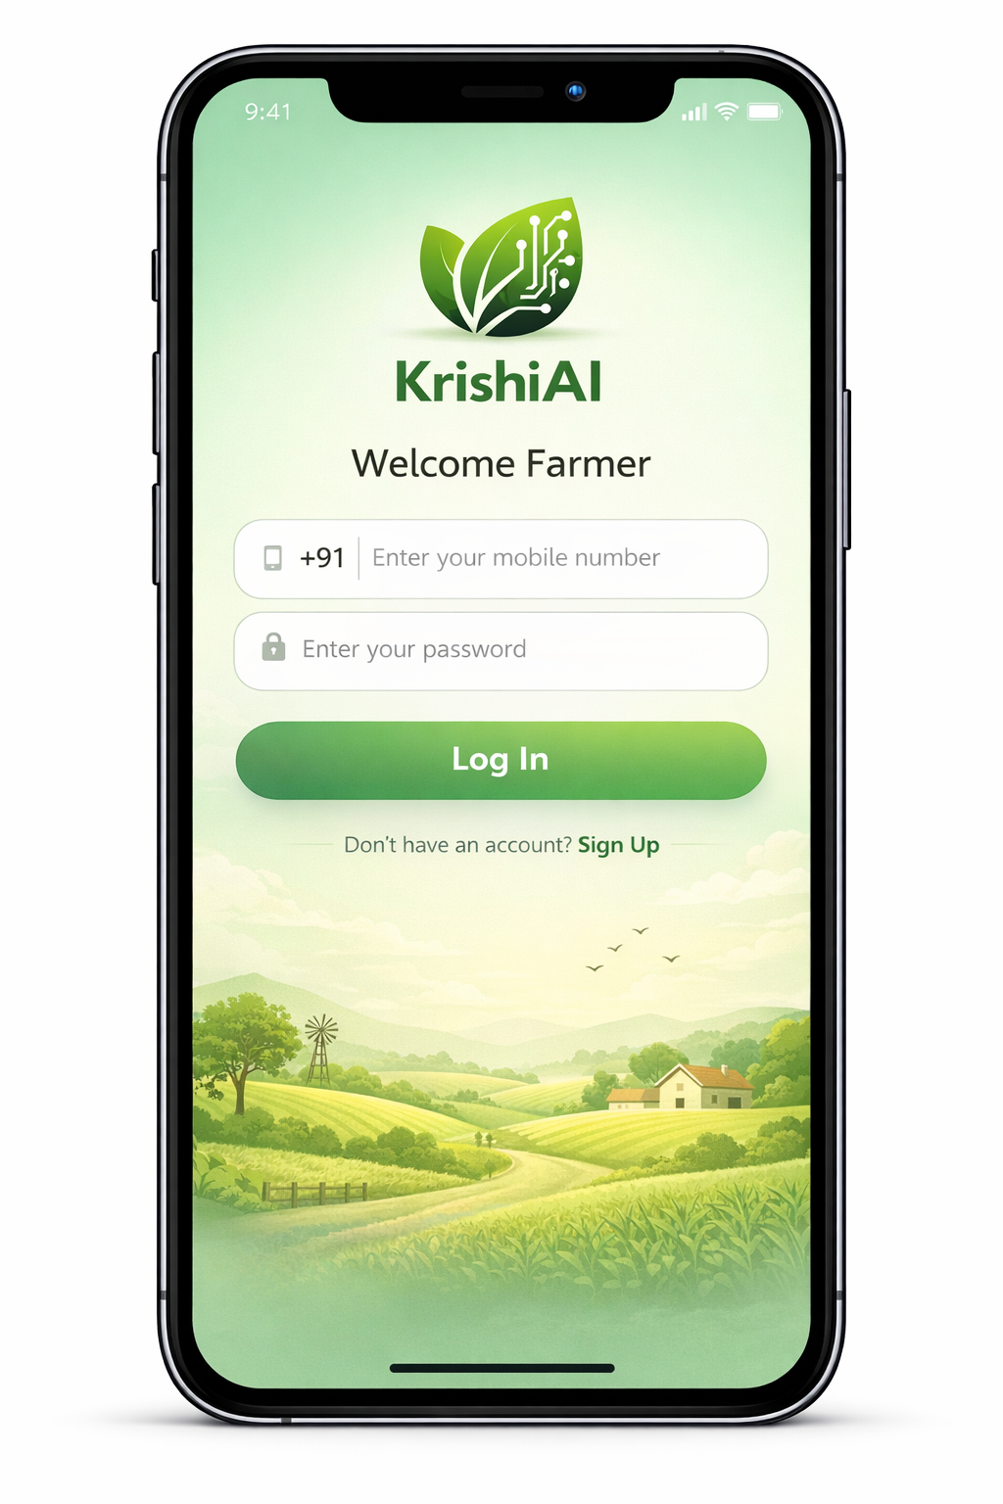
Wireframes/Mock diagrams:

Slide 8
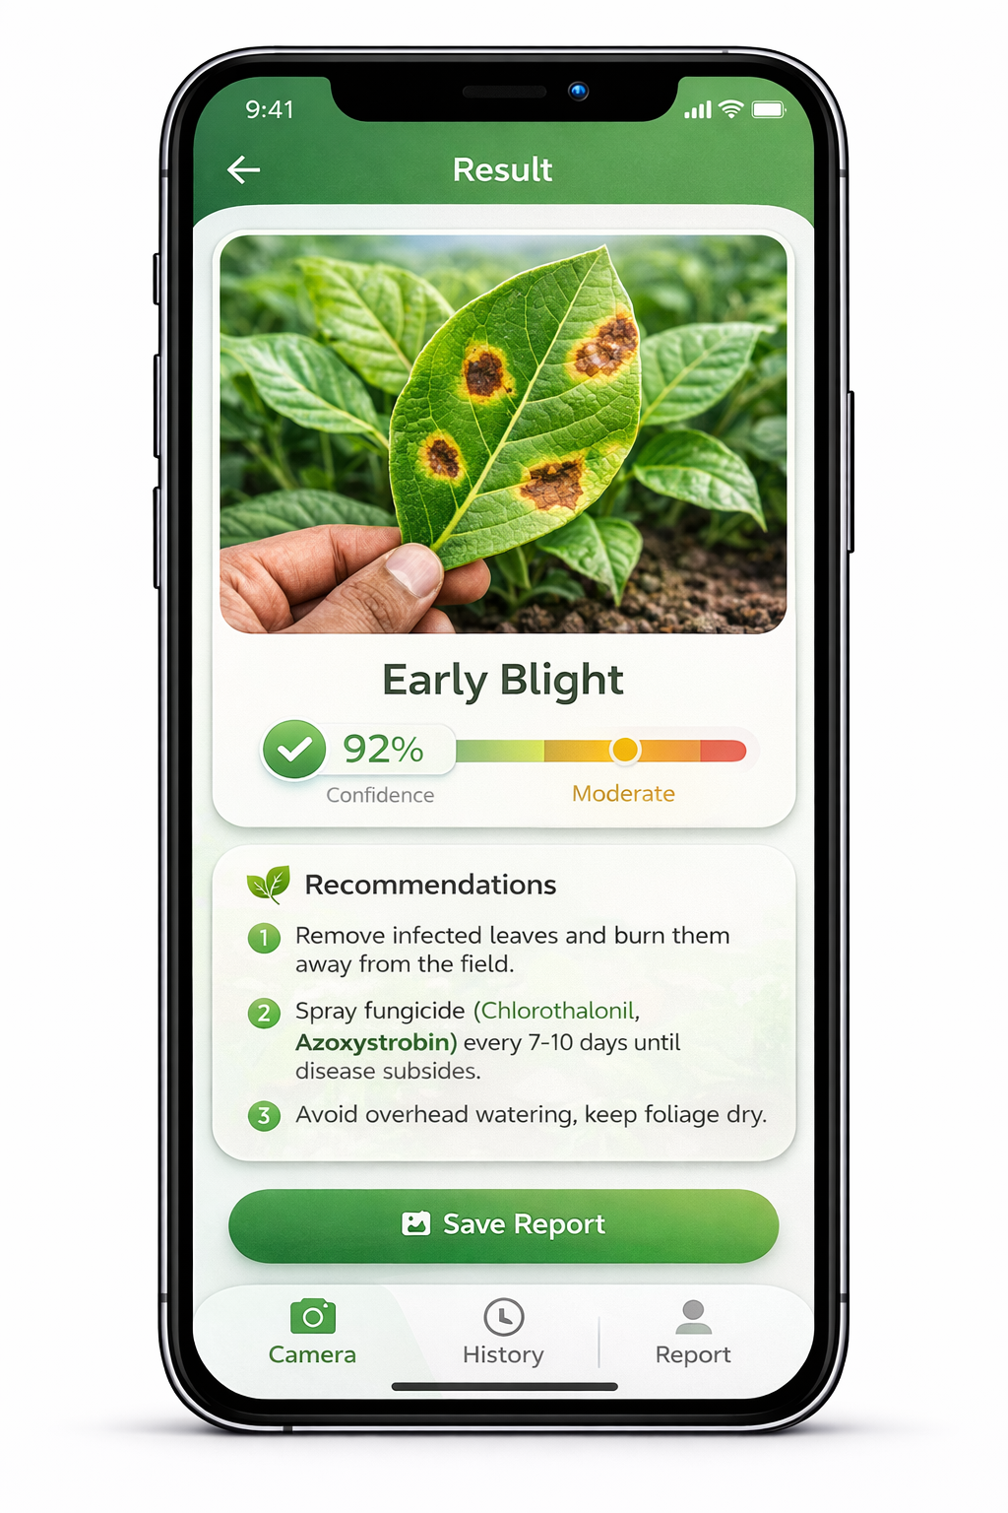
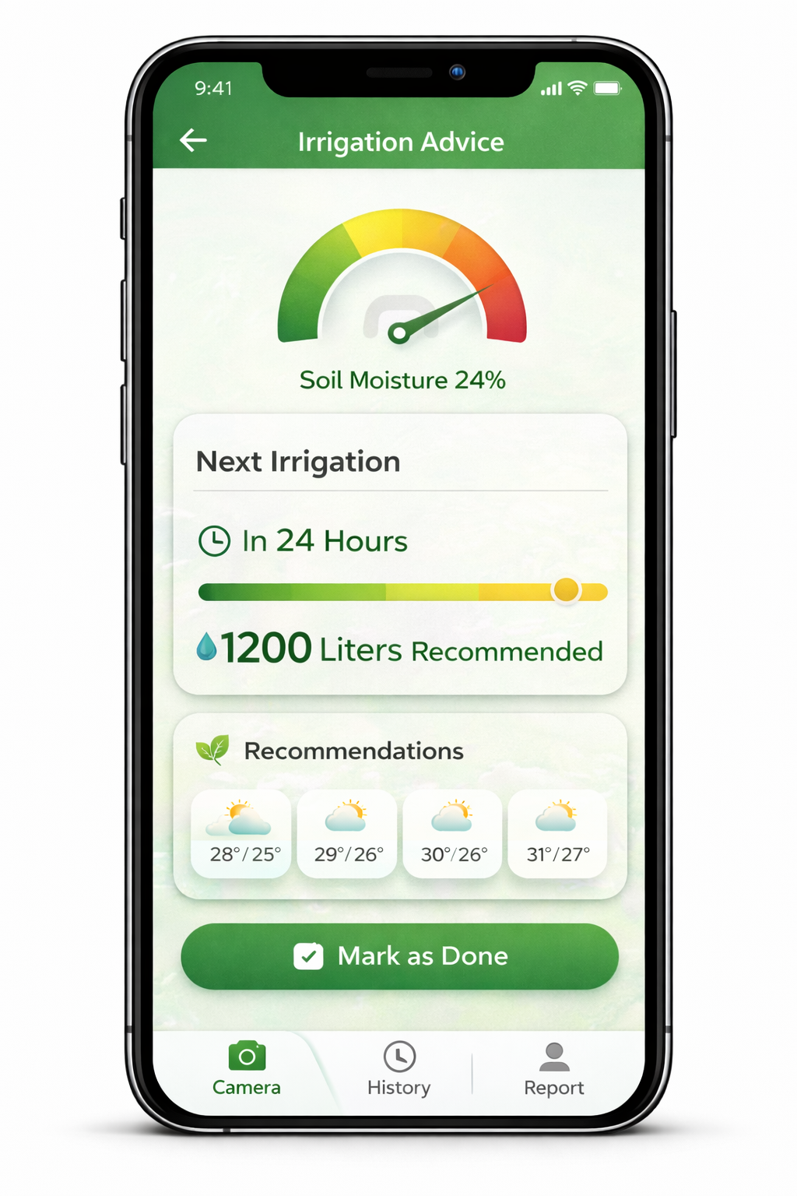
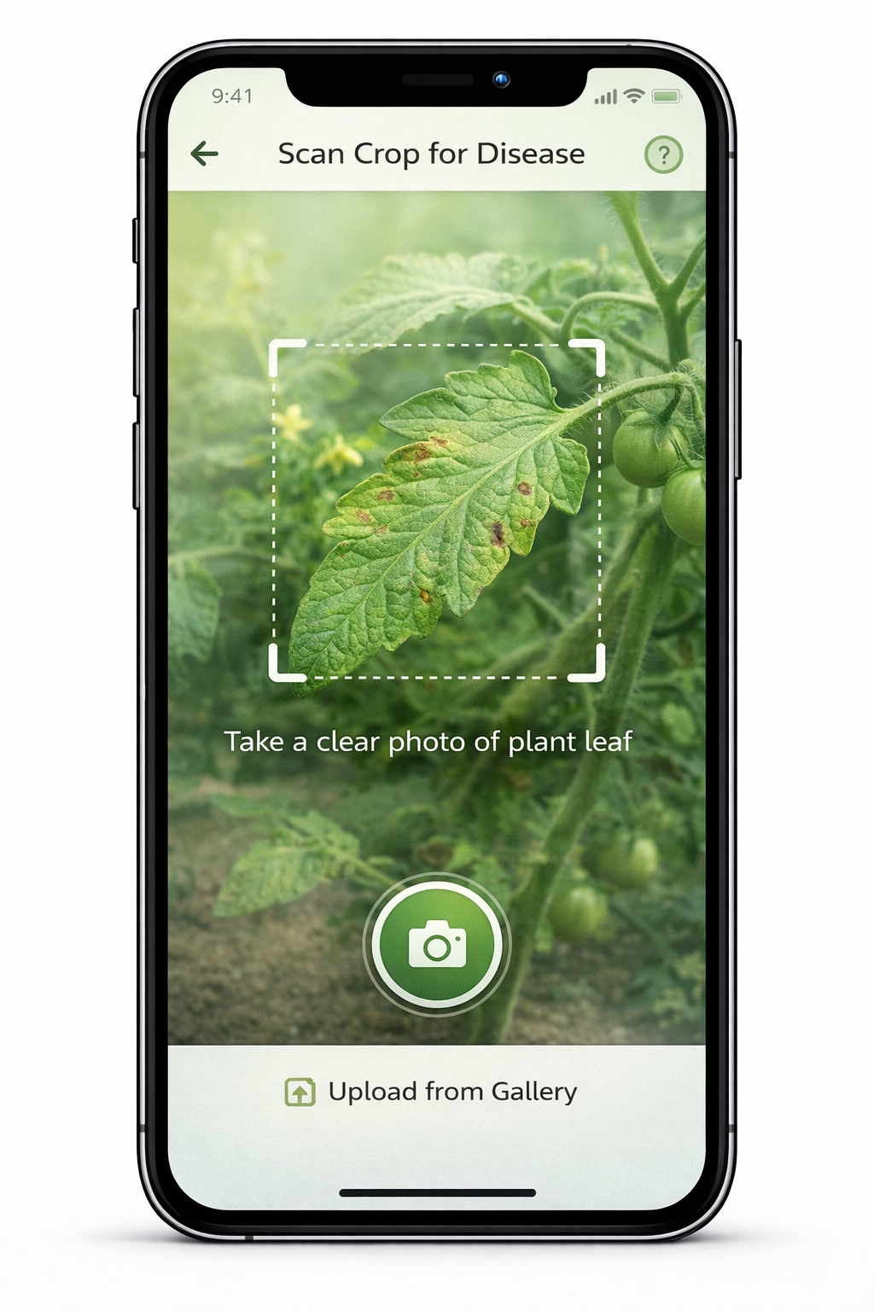
Wireframes/Mock diagrams:

Slide 9
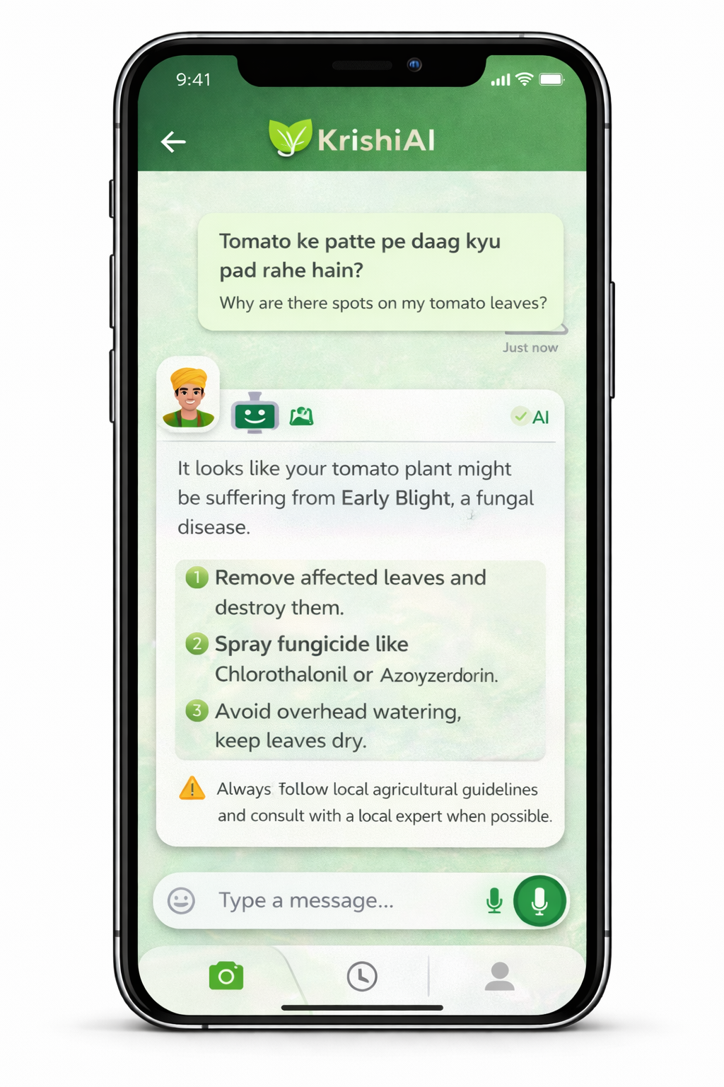
Wireframes/Mock diagrams:

Slide 10
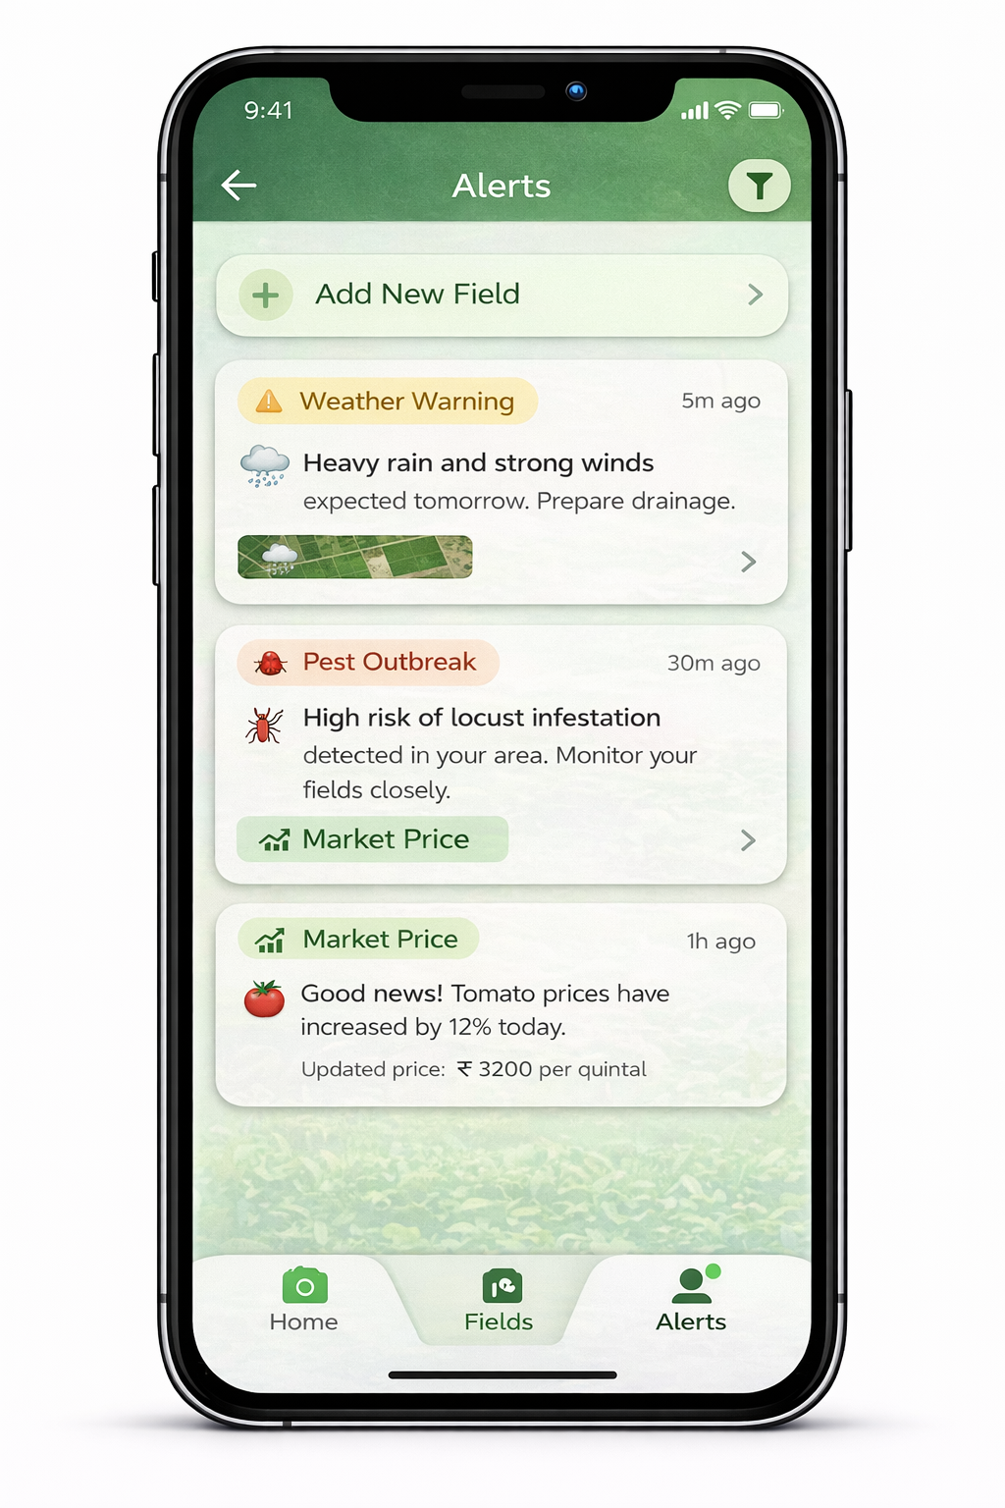
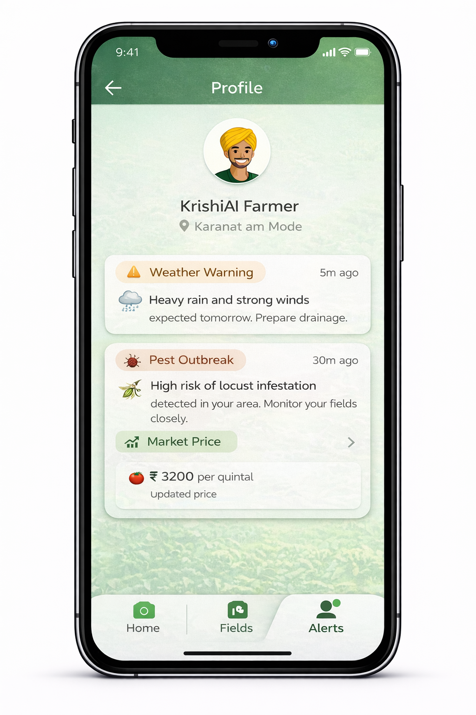
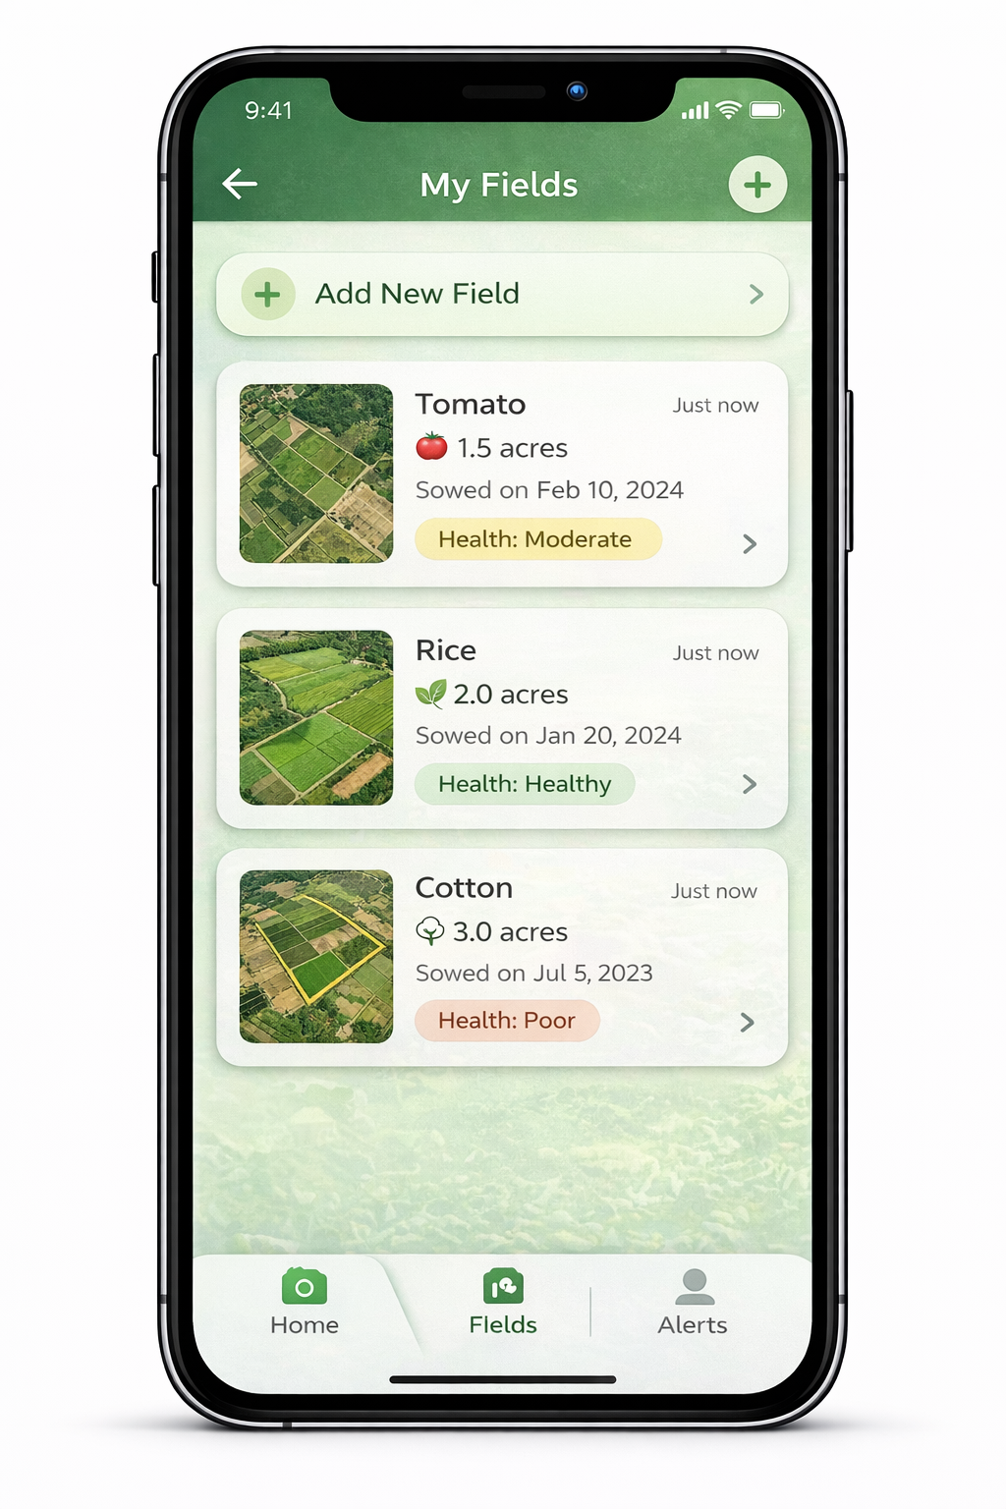
Wireframes/Mock diagrams:

Slide 11
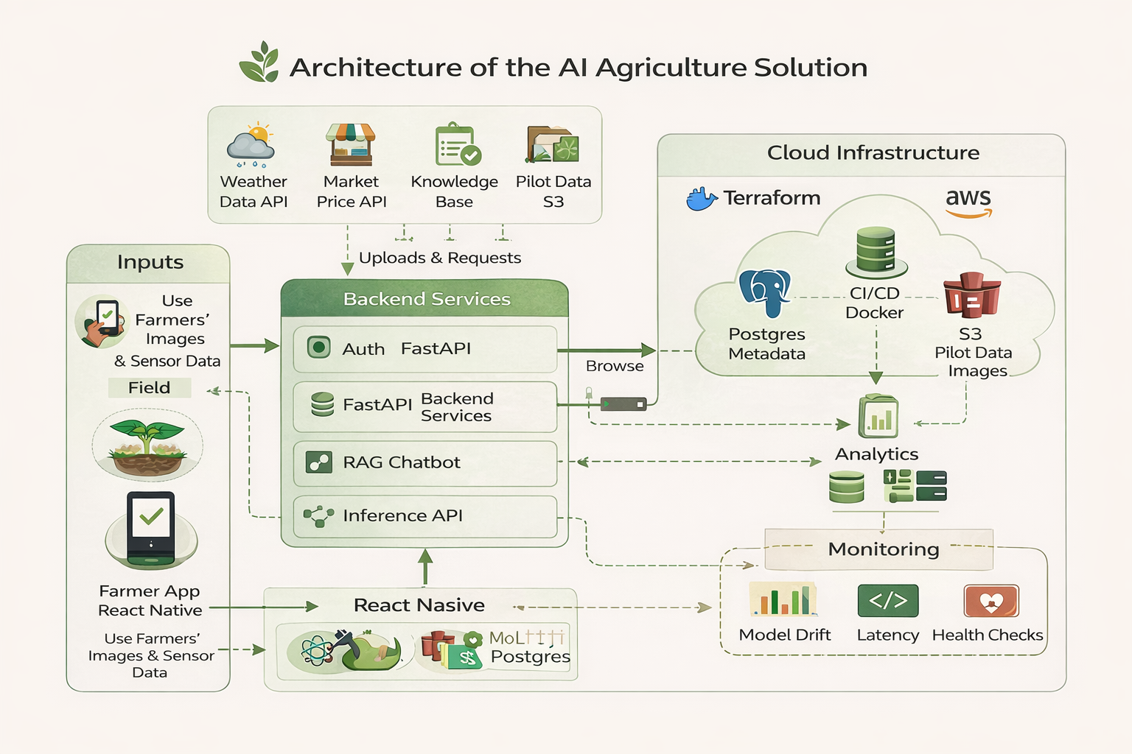
Architecture diagram of the proposed solution:

Slide 12
🧰 Technologies to be Used in the Solution (KrishiAI)
📱 Frontend / User Interface
React Native — Cross-platform mobile app development
React.js — Web dashboard for admin and analytics
TypeScript — Type-safe development
Material UI / Tailwind CSS — Modern UI design
🧠 Artificial Intelligence & Machine Learning
TensorFlow / PyTorch — Model training
TensorFlow Lite — On-device mobile inference
OpenCV — Image processing
Scikit-learn — Data analysis and predictive models
LLM APIs / NLP models — AI chatbot
⚙️ Backend Development
FastAPI / Node.js — Backend APIs
Python — ML and data processing
REST APIs — Communication layer
📊 Data & Analytics
Pandas / NumPy — Data processing
Power BI / Tableau / Grafana — Analytics dashboards
🌍 External Data Integrations
Weather APIs
Market price APIs
Satellite or IoT sensor data
☁️ Cloud & Infrastructure
AWS / Google Cloud / Azure — Cloud hosting
Amazon S3 / Cloud Storage — Image and data storage
Docker — Containerization
Terraform — Infrastructure as Code
🗄️ Database
PostgreSQL — Main relational database
MongoDB — Flexible data storage (optional)
Redis — Caching
🔐 Security
JWT Authentication
OAuth
Data encryption
🔧 DevOps & Monitoring
GitHub Actions / GitLab CI — CI/CD
Prometheus & Grafana — Monitoring
Logging tools

Slide 13
Estimated implementation cost (optional):
👉 MVP Development: $30K – $50K 👉 Annual Running Cost: $10K – $20K 👉 Includes development, cloud, and maintenance

Slide 14
Add as per the requirements for the hackathon:
🛠️ Estimated Implementation (Hackathon Version)
The proposed solution will be developed as a Minimum Viable Product (MVP) during the hackathon to demonstrate the feasibility and real-world impact of using Artificial Intelligence in agriculture. The implementation will focus on building core features such as crop disease detection using image recognition, a basic AI chatbot for farming assistance, and a simple dashboard to display insights. The system will be designed using open-source tools and lightweight cloud infrastructure to ensure quick development and scalability. The prototype will simulate real-time data using sample datasets and public APIs for weather and agricultural information. The solution will be developed in a modular way so additional features like smart irrigation and market prediction can be easily integrated in future versions. The implementation will emphasize usability, performance, and practical applicability in rural environments with limited connectivity.
⏱️ Development Timeline (Hackathon Scope)
Phase 1: Requirement analysis and design
Phase 2: Frontend UI development
Phase 3: Backend and API integration
Phase 4: AI model integration
Phase 5: Testing and demo preparation
👨‍💻 Resources Required
Laptop and development environment
Open-source frameworks and libraries
Sample datasets and APIs
🎯 Expected Outcome
The hackathon implementation will result in a working prototype demonstrating how AI can assist farmers in detecting crop diseases, accessing farming advice, and making better decisions. The prototype will validate the concept, showcase technical feasibility, and highlight the potential for scaling into a full production system.

Slide 15
